Slide 1
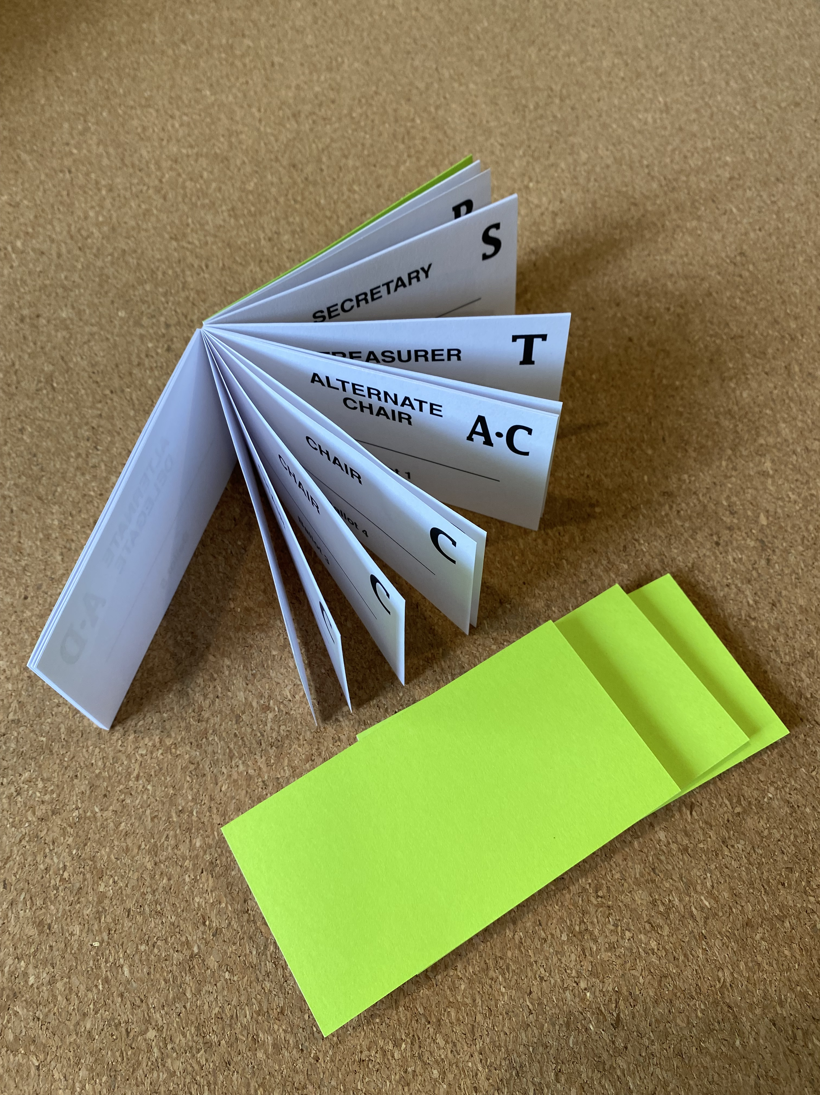
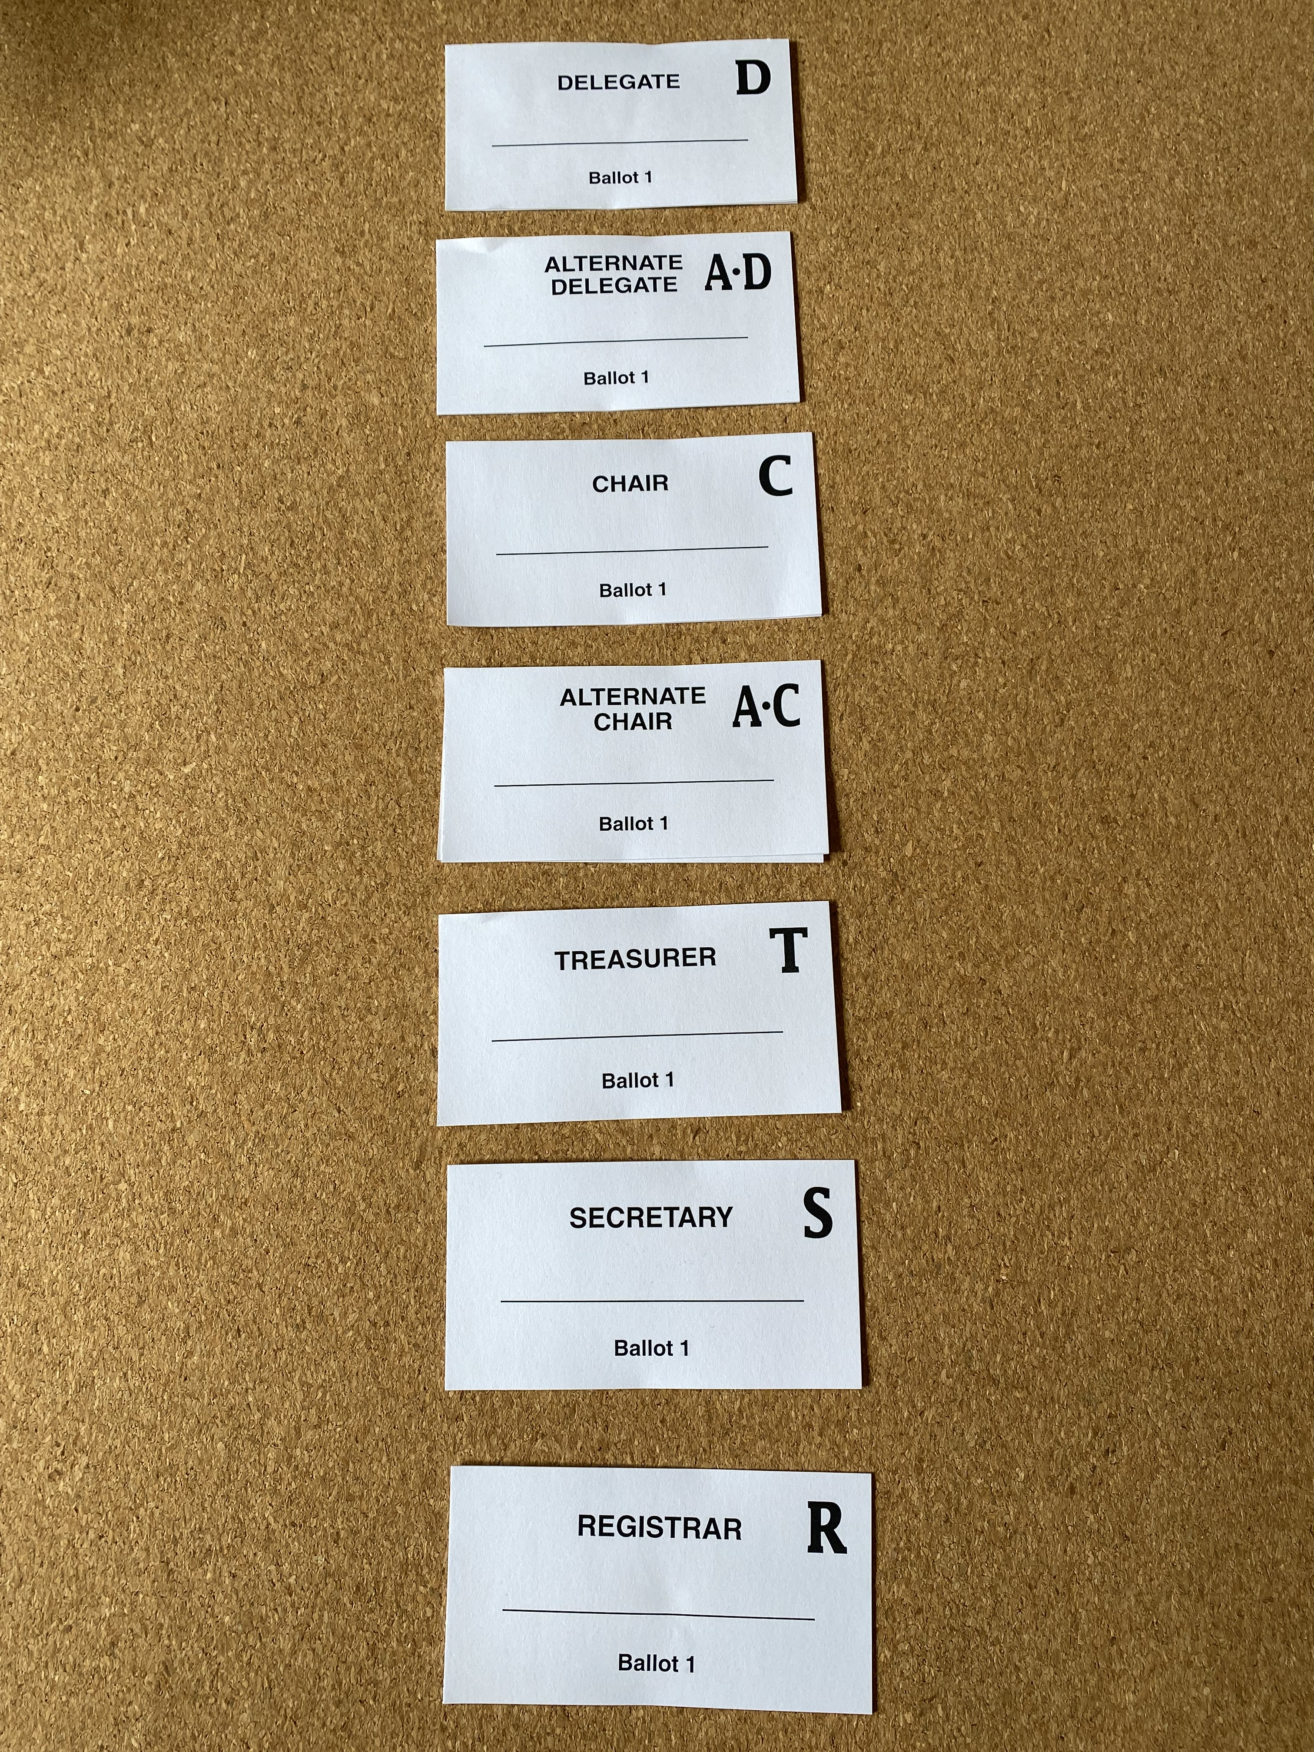
ELECTIONS & SPIRIT OF ROTATION
June Quarterly 2024
BC Yukon Area 79e

Slide 2
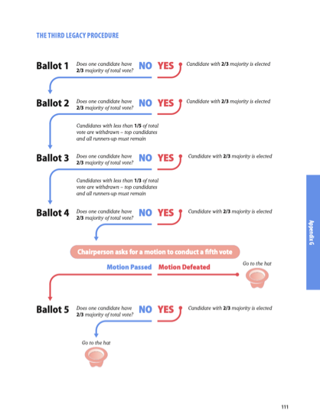
How does it work?
The outgoing Panel 73 delegate facilitates the Panel 75 election.
We start with the 7 elected positions in order:
delegate; alternate delegate; chair; alternate chair;
treasurer, secretary and registrar
2 min service resumes are read prior to voting
Polls will be used for those attending virtually.
Paper Ballots will be used for those attending
in person.
Final total is tabulated and applied to our
Third Legacy Procedure.

Slide 3
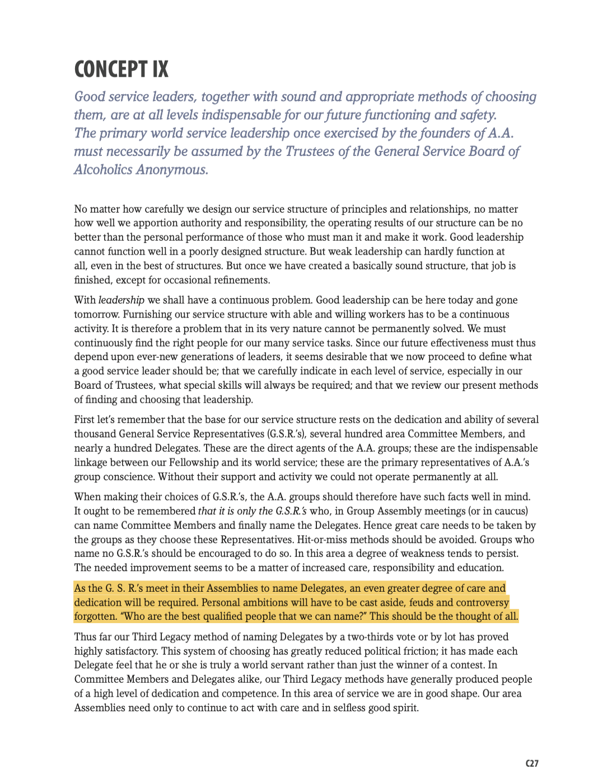
Some districts and groups will have their current GSRs and DCMs attending the assembly along with their incoming GSRs and DCMs. It is suggested that the current DCM and GSR have voting privileges since they have the experience and have been serving with the candidates who are in the election.
From Concept IX, page C27, “As the GSRs meet in the assemblies to name the delegate, an even greater degree of care and dedication will be required. Personal ambitions will have to be cast aside… “Who are the best qualified people that we can name? This should be the thought of all.”

Slide 4
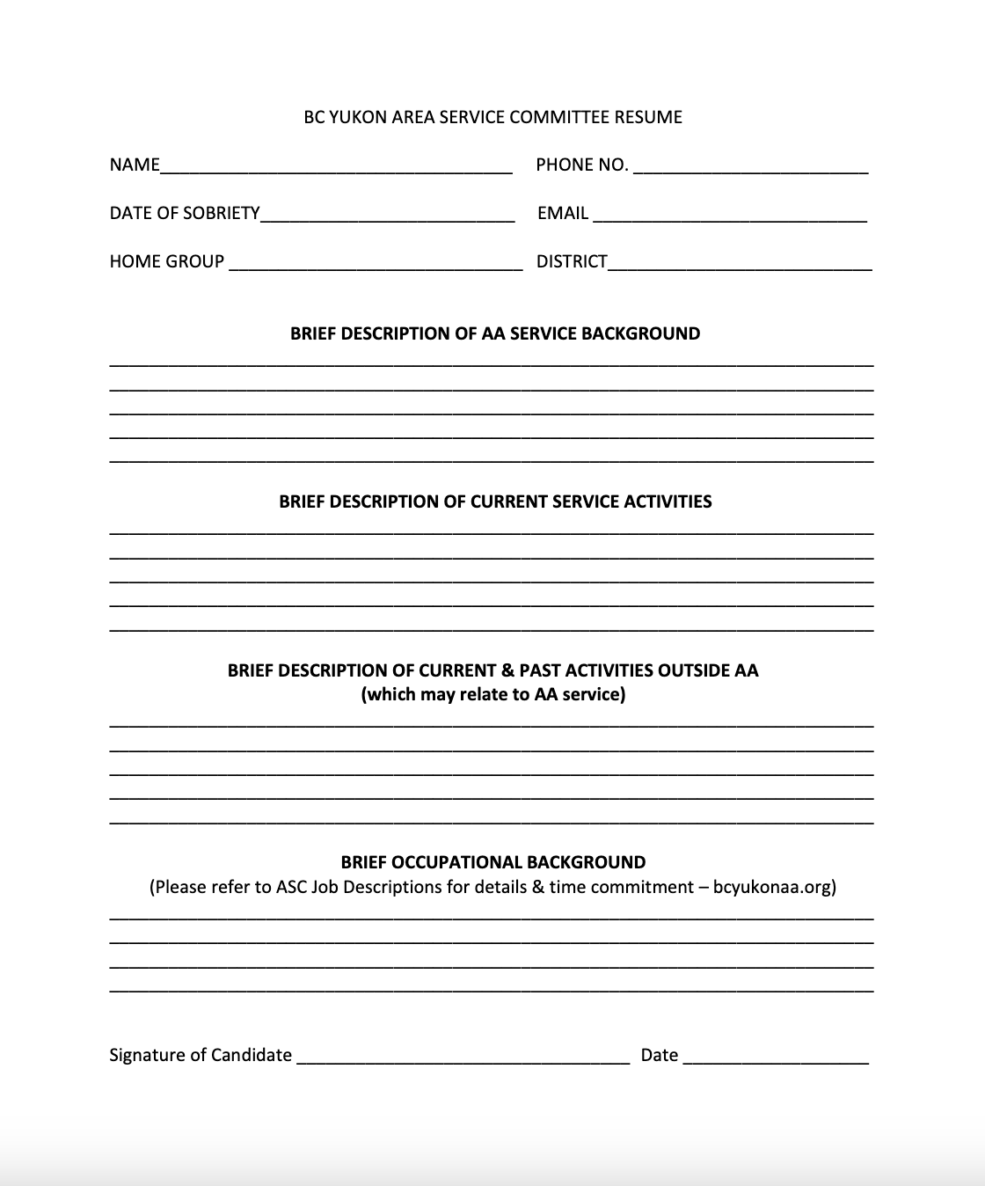
Listen to the service resumes?
We encourage DCMs, ASC members and past trusted servants to consider letting your name stand. Research the position you are interested in and ask yourself…Am I willing to serve? Do I have the skills needed or am I willing to learn new skills? Do I have the time? Then prepare your service resume.
Be aware that the resumes are read at the start of the each election position. There is a 2 min time limit. If candidates put their names up for more than one position you will only hear their resume once.
form is on our website under
Area 79-Elections & Appointments

Slide 5
ELECTIONS
A white board will be at the front of the room and candidates will place their name under the service positions they are willing to stand for.
These 7 elected positions are elected in this order.
Delegate | Alternate Delegate | Chair | Alternate Chair | Treasurer | Secretary | Registrar
John | Susan | Kathy | Ben | Tim | Dean | Allen
Jody | Sam A. | Karen | Betty | Tom | Duncan | Abigail
James | Stuart | Kevin |  | Tammy | Debbie | Alice
 | Sam E. |  |  | Tegan |  | Adam

Slide 6
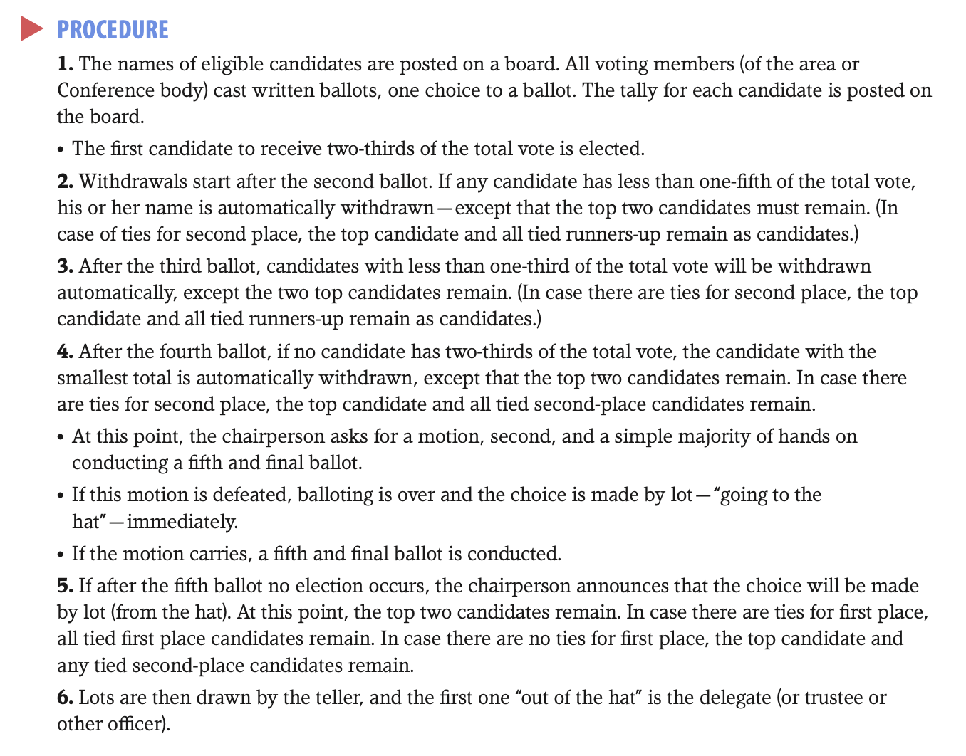

Slide 7
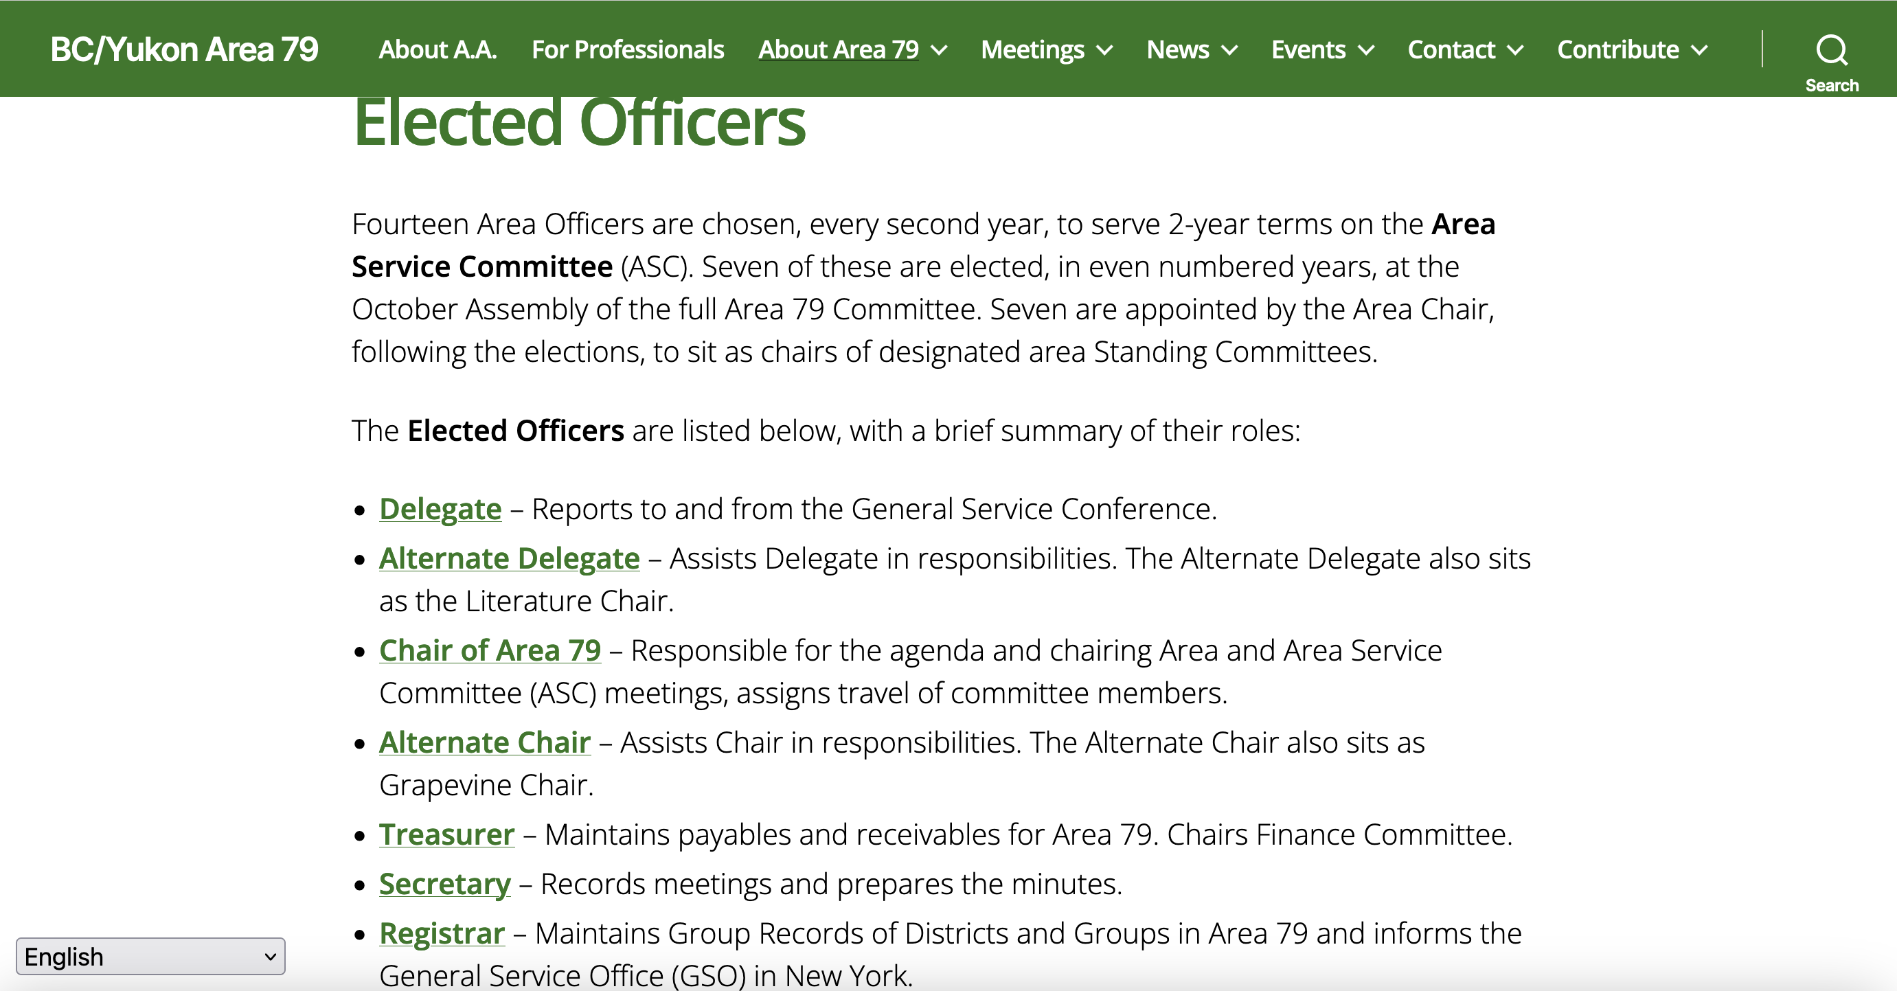
How you can prepare
“The Area
Committee”
Pages 26-31
Area Officers:
Qualifications
& Duties
It is suggested that we familiarize ourselves with the duties and qualifications of the 7 elected service positions.
Start by reading pages 26-31 “Area Officers: Qualifications & Duties” in our A.A. Service Manual and also read the “job descriptions” on our Area 79 Website and in our GSR Handbook starting on page 13.
Ask questions of those who are currently serving in these positions here this weekend or of others who have served at the area level in the past.
On learning what each service position entails and reviewing Concept IX, (Page C29) which includes Bill W.’s article, Leadership In A.A.: Ever A Vital Need, you can make a more informed decision on who are the best candidates for our area service committee positions.

Slide 8
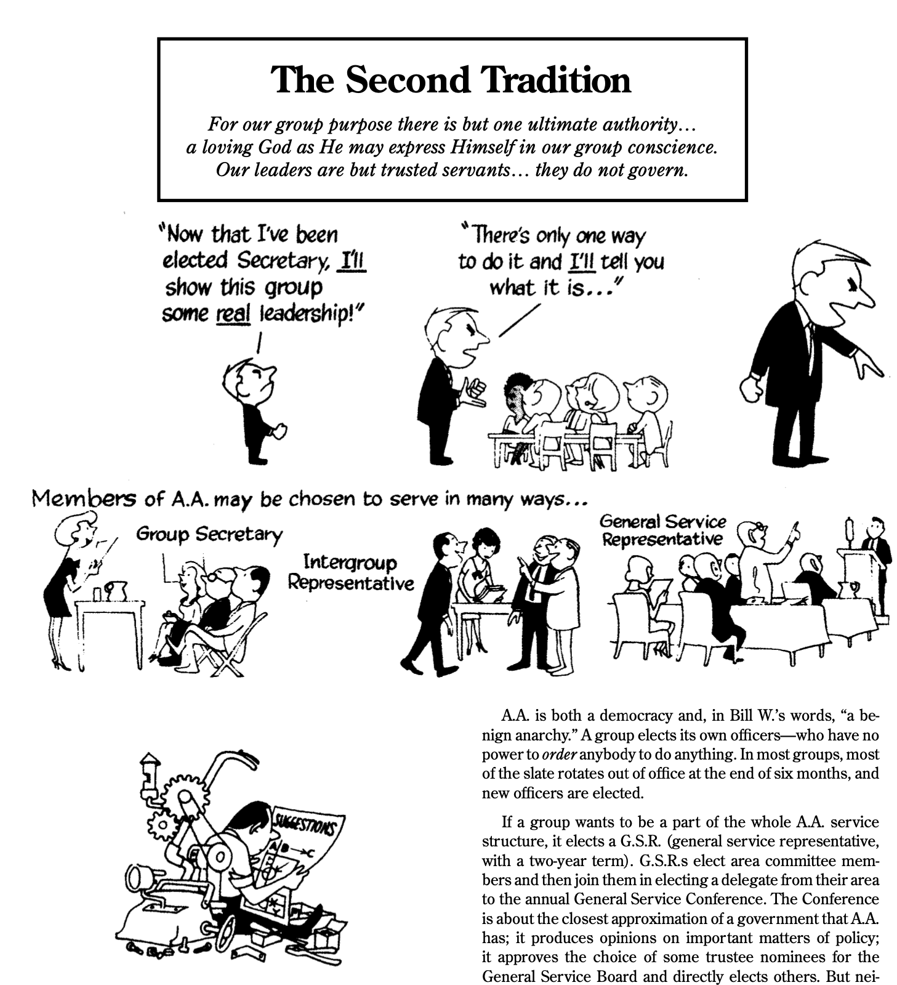
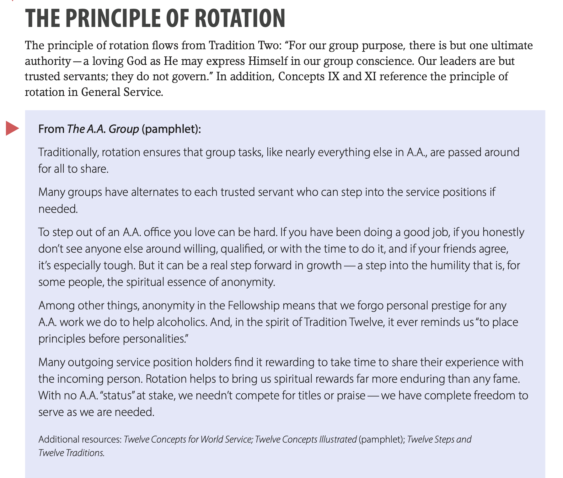
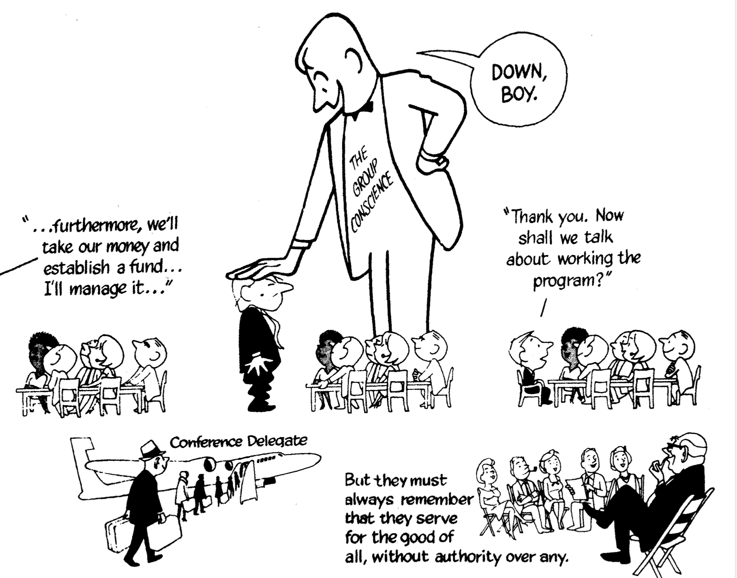
Pages 4&5
The Twelve Traditions
illustrated
Service Manual Page 107

Slide 9
After the election Appointed Positions are selected
Our appointed positions are:
Archives CPC Corrections
Public Information Remote Communities Treatment/Accessibilities Website
and the Grassroots Forum Newsletter
The positions are appointed by the incoming Chair through a Selection Committee made up of the incoming Chair and 3 other elected ASC members.
Please email your service resume directly to: resume@bcyukonaa.org
The deadline for appointed position resumes is October 31, 2024

Slide 10
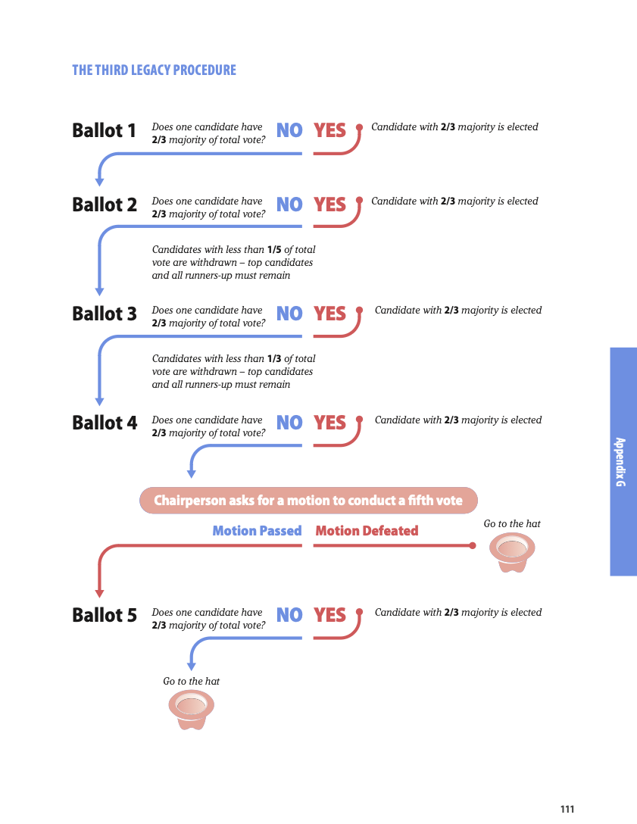
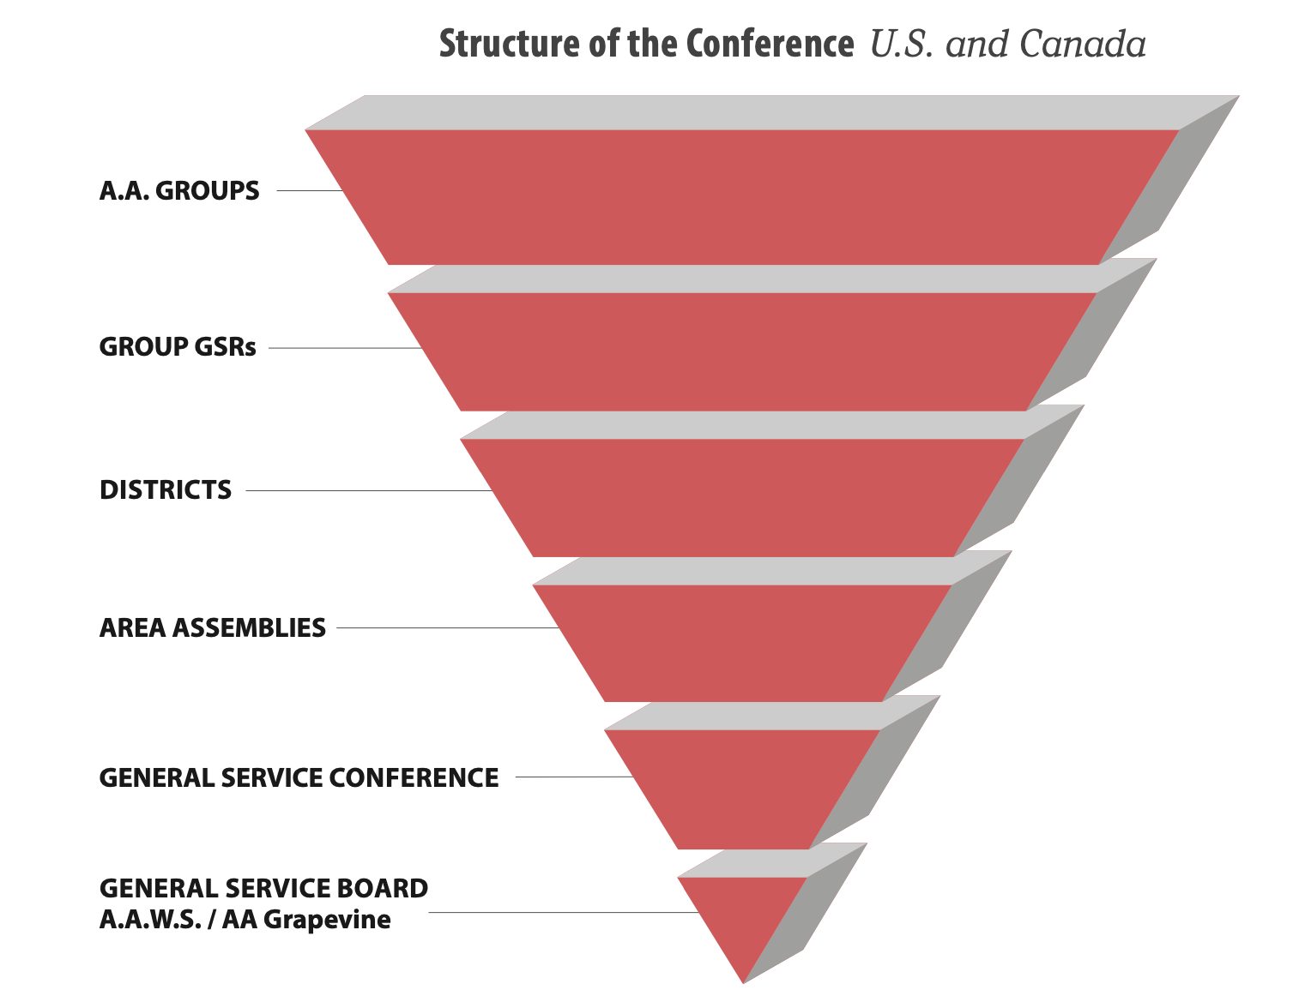
How does your group or district fill positions?
GSR’s
DCM’s

Slide 11
Questions

