Slide 1

MOTION ORIENTATION
June Quarterly 2024
BC YUKON AREA 79

Slide 2


ADDITIONAL READING
For more details check out….
Pg 18
Pg 12

Slide 3

September 2024 Voting and Election Assembly
We consider motions pertaining to Area matters and matters that we may wish to suggest be considered by the Conference affecting A.A. as a whole.

Slide 4

If your group, district or committee is considering submitting a motion, please try to submit it to the Area Chair as early as possible.
Remember that we are trying to find the collective conscience of all of the groups in our Area so the sooner your motion is submitted the better chance we have to fulfill our purpose.

Slide 5
AREA 79 RESOURCES:
MOTION GUIDE:
This guide is intended to provide assistance to our fellowship when drafting motions.
Downloadable:
Login Side of BC/Yukon website:
Services
→ Service Materials

Slide 6

ABOUT MOTIONS
A motion, the question, brings business before the assembly.
Good motions are simple and clear
Needs to be answered with a “yes” or “no.”

Slide 7
MOTION FORM
All motions submitted by July 7 will be included in the Voting and election Assembly Agenda package and distributed to all of our Area 79 groups providing them an opportunity to discuss the motions prior to the Assembly.

Slide 8
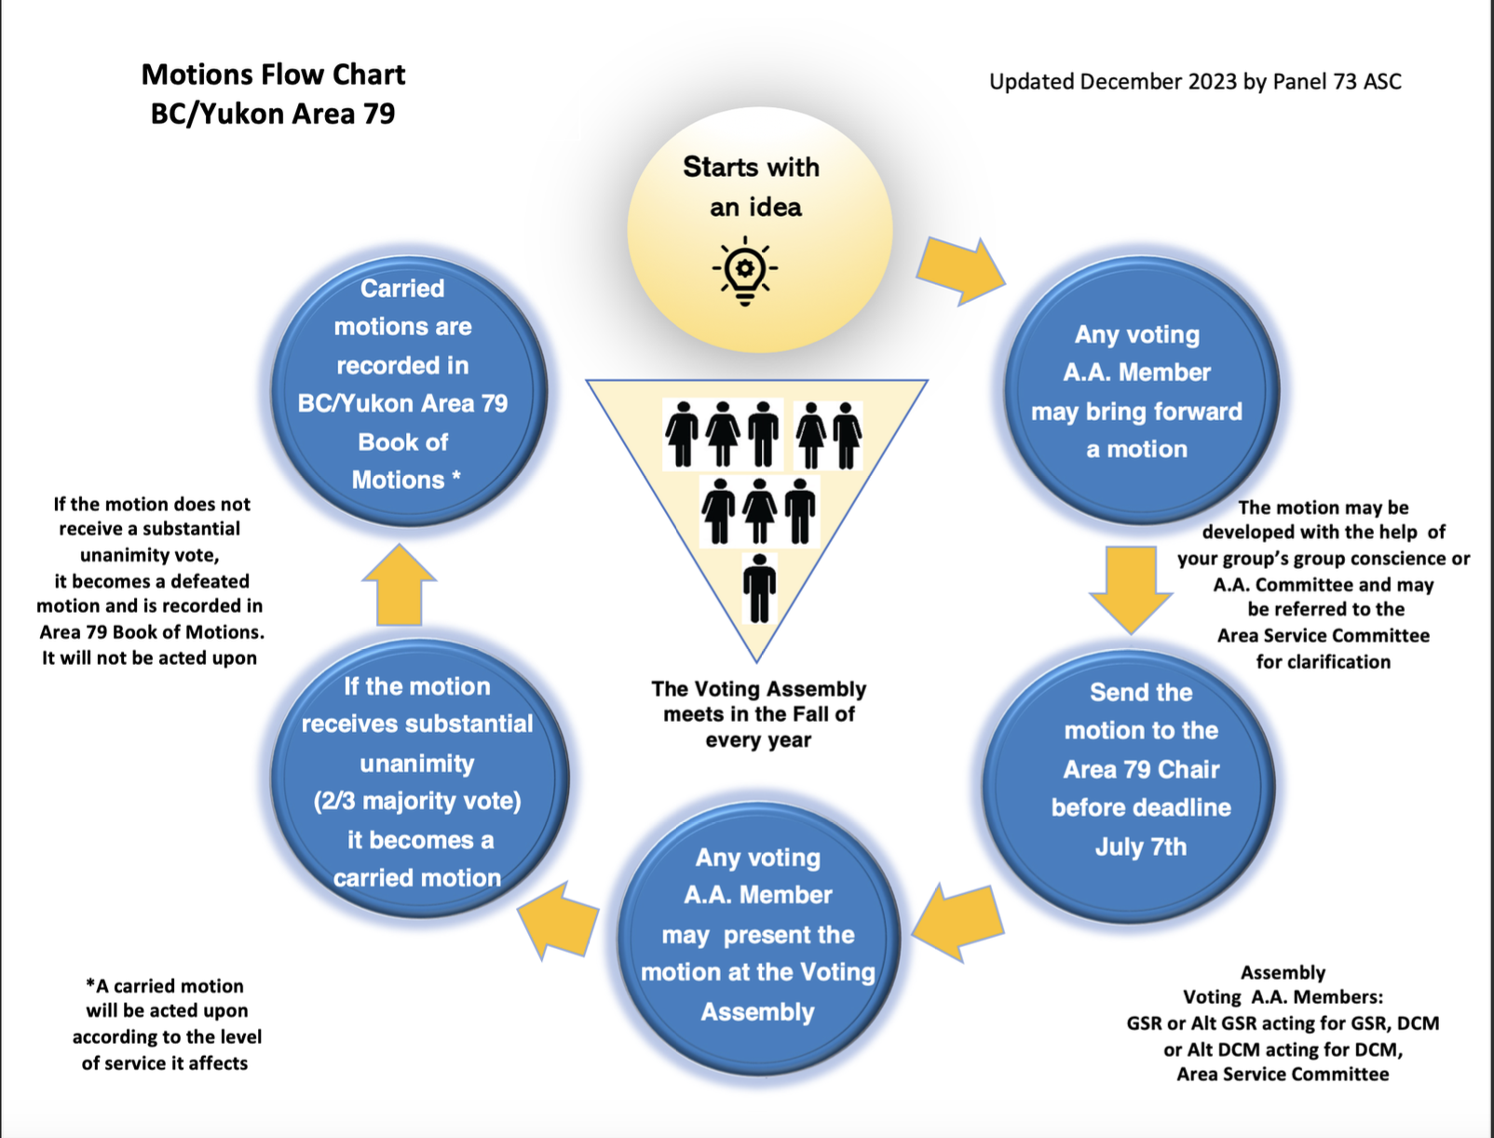

Slide 9
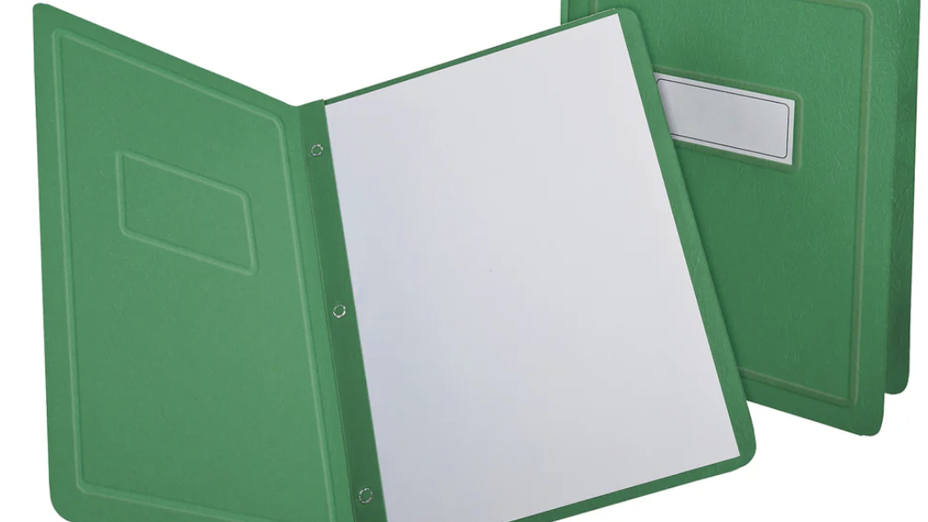
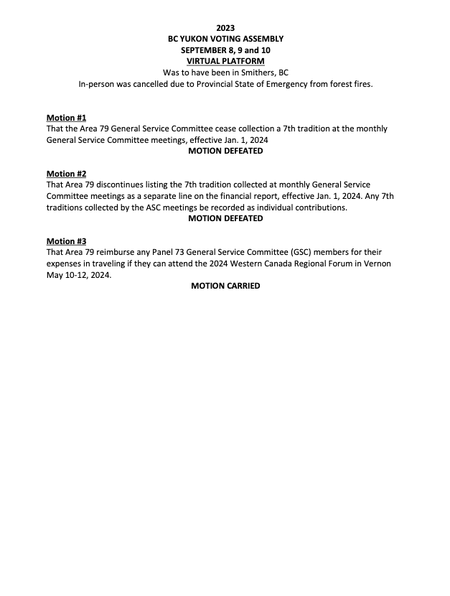


Slide 10
FLOOR ACTIONS
Motions may be submitted until 11 am on Saturday, September 7th of the Assembly and will be treated as a floor action.
The exception -> motions regarding financial matters (other than budgets) in excess of $2,000.00 must be submitted no later than July 7, so they are included in the Voting and election Assembly Agenda package for distribution to all registered groups in Area 79.
(Footnote: BC/Yukon Area 79 Book of Motions- 2010 Armstrong, BC-Motion 4)

Slide 11
Great way to see our floor action process from beginning to end
Great way to see our floor action process from beginning to end

Slide 12
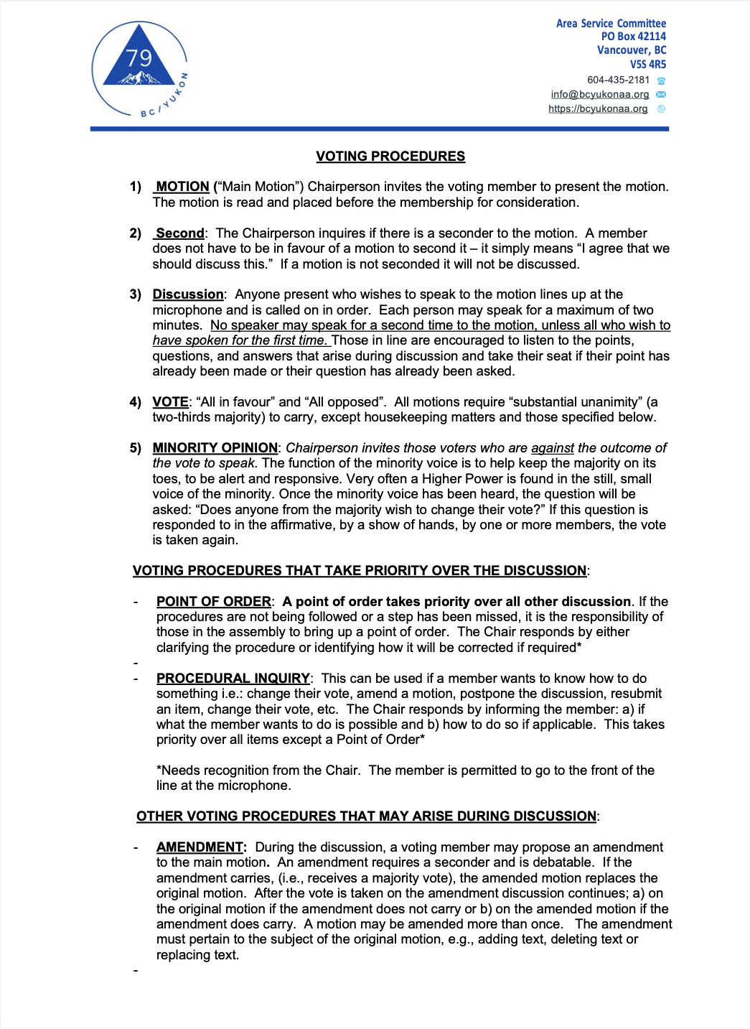
Voting Procedures in Area 79
Every motion goes through the following:

Slide 13
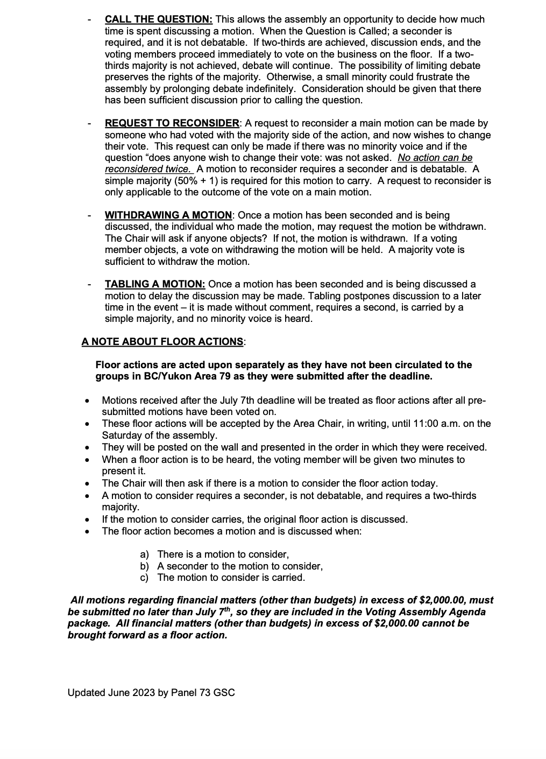
Voting Procedures in Area 79 continued…

Slide 14
Another
Area 79 Resource
(1,2,3 Sheet)

Slide 15
When voting you may want to consider:
ARE YOU IN FAVOR
NOT IN FAVOR?
MINORITY VOICE
IT IS IMPORTANT
LISTEN / DO YOU REPEAT?
CALLING THE QUESTION

Slide 16
When voting you may want to consider:
AMENDMENTS
1,2,3 SHEET
RIGHT OF DECISION

Slide 17

What happens to a motion that carries?
Motions that are carried at our Voting Assembly for consideration for the Conference Agenda are submitted by our Delegate to the General Service Office (to the attention of the Conference Coordinator). Those motions that are carried concerning the Area are followed through by the Area Service Committee.

Slide 18

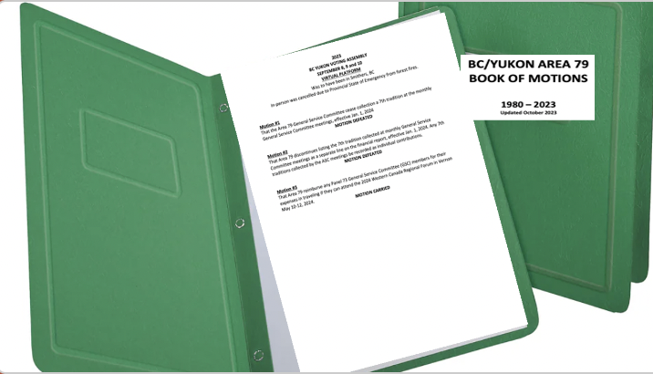
Any Questions

