Slide 1
AREA 79 MOTION RESOURCES
June Quarterly 2023
Kelowna, BC

Slide 2
MOTION GUIDE
Page #1
2 page document found on the Area Website
Login Side under Chair page.

Slide 3
MOTION GUIDE
Page #2
This document is also in your agenda package this weekend!

Slide 4
AREA 79 BOOK OF MOTIONS

Slide 5
MOTIONS FLOW CHART
Great way to
see our motion process
from beginning to end.

Slide 6
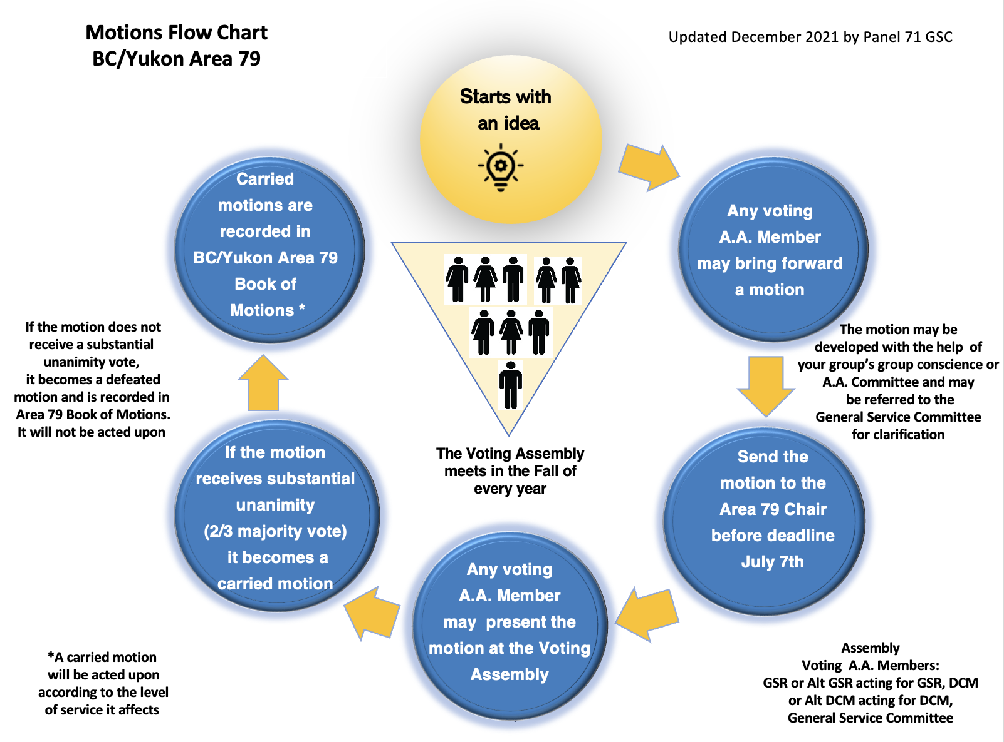

Slide 7
YOU ARE NOT ALONE
June Quarterly 2023
Kelowna, BC

