Slide 1
BC Yukon AREA 79, PANEL 71
January 2021 Service Orientation
Presenters:
Bob K & Rio D

Slide 2
Sections
01
WELCOME AND INTRODUCTION
04
AREA 79 APRIL 2021 PRE-CONFERENCE
02
RESOURCES AVAILABLE TO SUPPORT YOUR SERVICE POSITIONS
05
WESTERN CANADA REGION ALCOHOLICS ANNOYMOUS SERVICE ASSEMBLY
03
GENERAL AA SERVICE CONFERENCE

Slide 3
WELCOME AND INTRODUCTION
1

Slide 4
Welcome…
… To Panel 71. You will be representing Area 79 over the next 2 years.
We would like to thank:
General Service Representatives [GSRs] and their Alternates
District Committee Members [DCMs] and their Alternates
General Service Committee [GSC]
Past Trusted Servants and Friends
For their dedication, passion and being of service helping the suffering alcoholic.

Slide 5
Virtual Platforms as the New Normal for AA Meetings, Assemblies and Conferences – 2020 - 2021
In 2020, were you familiar with the term “virtual platform”? It was almost a year ago that the COVID-19 pandemic hit and changed how we conduct all services in AA including our recovery meetings, our group, district and area business meetings. We have come to work from home to use the video apps available. We are a diverse society that has adapted well and is continuing to find ways to help the suffering alcoholic. AA events across the world have gone virtual. Virtual meetings, including virtual handshakes and hugs are the new temporary normal.

Slide 6
The New Normal for Meetings – 2020 -2021
Now for the start of the Service Orientation.

Slide 7
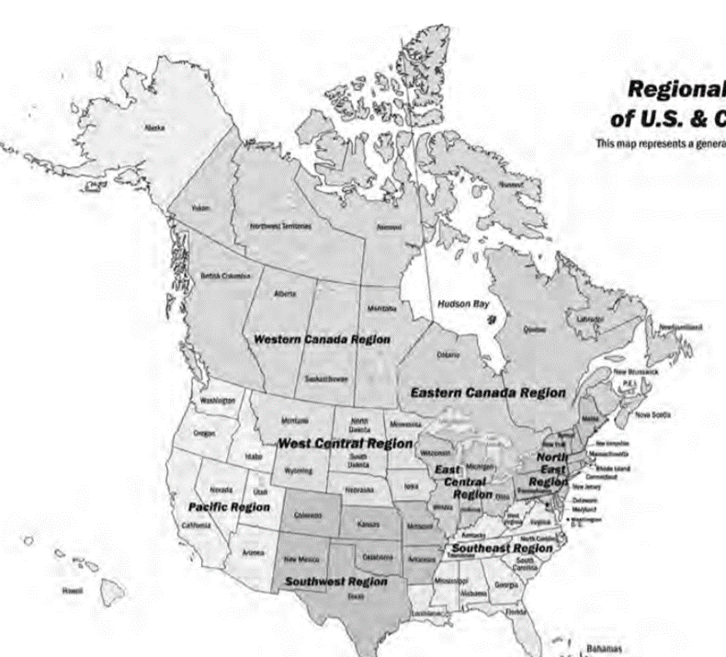
What is an Area?
Regional Map of U.S. and Canada
An area may be part of a state or province, or all of it, or may include parts of more than one state or province, depending on the size and needs of the A.A. population.
In any case, the area holds an important middle position in the Conference structure — through the elected delegate, it participates in A.A. worldwide, while through the D.C.M.s and G.S.R.s, it is close to the local scene.
The US/Canada AA structure is made up of eight regions consisting of 93 areas.
This map represents a general outline of Regions.

Slide 8
Canadian Regions and Areas
Nunavut 78
The BC/Yukon Delegate Area 79 makes up 1 of the 4 areas of the Western Canada Region.
Area 79 includes the Yukon Territory, most of British Columbia and one small section of Washington. At 1,431,250 square kilometres, it is the second largest Delegate Area in Canada/USA. Area 79 includes Districts that are of equal size to the states of Mississippi and Maryland combined, not to mention Districts that are as big as the third-largest state in the US, smaller only than Texas and Alaska. From the southernmost tip of British Columbia to the northernmost tip of the Yukon Territory is a staggering 2,540km/1,587 mi.
Northwest Territories 78
Yukon 79
Nunavut 90
British Columbia
79
Labrador 82
Quebec 89
Alberta 78
Hudson Bay
Newfoundland
Sask
91
Manitoba 80
82
Ontario
85
New Brunswick (81)
81
82
PEI (81)
Nova Scotia
84
90
88
87
83
 | Western Canada Region |  | Eastern Canada Region
86

Slide 9
United States Regions and Areas
xxx
Maine
28
Washington
72
Idaho
18
Vermont 70
Alaska
Montana
40
Oregon
58
North Dakota 52
35
Minnesota
36
New
York
New Hampshire 43
92
74
66
Massachusetts 31 & 30
Wisconsin
74
75
34 32
Michigan
33
Rhode Island 61
South
Dakota 63
50
47
Wyoming
76
60
Pennsylvania
59
Connecticut 11
California
Iowa
24
55 54
Ohio556 53
New Jersey 44 & 45
7
Nevada
42
Nebraska 41
20
Illinois
21
22
Indiana
23
Delaware 12
6
Utah
69
Virginia
71
Colorado
10
Maryland 29
39
Missouri
38
26
Kentucky
Washington DC 13
Kansas
25
51 North Carolina
West Virginia 73
42
Tennessee
64
93
Arizona
3
New
Mexico
46
Oklahoma
57
Arkansas
4
5
9
Texas
Miss--issippi
37
1
Ala-
bama
Georgia
16
8
66
South Carolina 62
65
27
Louisiana
14
Florida
15
Hawaii
17
67
68
 | Pacific Region |  | West Central Region |  | Southwest Region |  | East Central Region |  | Southeast Region |  | North East Region

Slide 10
What Is Panel 71?
Beginning on January 1, 2021 your new General Service Committee begins a two-year term as your Panel 71 GSC.
AA in North America is divided into Panels, with half of the Panels being “odd’ years” and half of the panels being “even” years.
That means that, in any one year, throughout North America, about half the AA groups are busy electing GSRs, and in the same year, Area Assemblies are electing qualified delegates to attend the annual Conference meeting in New York.
In Area 79’s case, we are an “odd” panel (no jokes, now) and we elected yours truly, (Bob K), as our Panel 71 Delegate. I will be attending the 71st Annual Meeting of the General Service Conference (the second ever virtual platform) of Alcoholics Anonymous in April 2021, and the 72nd Annual Meeting in April of 2022 (hopefully in person).
ODD Todd
EVEN Steven
The rest of the Area 79 General Service Committee will be serving with me for this two-year term, which makes us the Panel 71 GSC. One important reason for this is that A.A continues to operate with experienced delegates.
If you would like more information regarding panels and Delegate Areas, you can find more in “The AA Service Manual” on pages S111 – S113.

Slide 11
RESOURCES AVAILABLE TO SUPPORT YOUR SERVICE POSITIONS
2

Slide 12
Resources Available To Support Your Service Positions
AA Service Sponsor
“…A.A. service is anything whatever that helps us to reach a fellow sufferer Sponsorship in A.A. is basically the same, whether helping another individual’s recovery or service to a group. It can be defined as one alcoholic who has made some progress in recovery and/or performance in service, sharing this experience with another alcoholic who is just starting the journey. Both types of service spring from the spiritual aspects of the program.
Individuals may feel that they have more to offer in one area than in another. It is the service sponsor’s responsibility to present the various aspects of service: setting up a meeting; working on committees; participating in conferences, etc.
In this matter it is important for the service sponsor to help individuals understand the distinction between serving the needs of the Fellowship and meeting the personal needs of another group member.
A service sponsor is usually someone who is knowledgeable in A.A. history and has a strong background in the service structure. The A.A. member is introduced to a new language: G.S.R., D.C.M., area assembly, minority opinion. They will become familiar with the Traditions, Concepts and Warranties, as well as The A.A. Service Manual/Twelve Concepts for World Service, Alcoholics Anonymous Comes of Age and other A.A. literature.
Co-founder Dr. Bob said, “I spend a great deal of time passing on what I learned to others who want and need it badly. I do it for four reasons:
1. Sense of duty.
2. It is a pleasure.
3. Because in doing so I am paying my debt to the man who took time to pass it on to me.
4. Because every time I do it, I take out a little more insurance for myself against a possible slip.”
The basis of all sponsorship is to lead by example. Service sponsors can impart to their sponsees the pleasure of involvement in the work of Alcoholics Anonymous. This is best done by stressing the spiritual nature of service work and by pointing out the usefulness of simple footwork and faith.

Slide 13
Resources Available To Support Your Service Positions
A.A. Literature
Literature published by A.A. World Services, Inc. is a resource for the recovering alcoholic and for anyone who wants to find out about Alcoholics Anonymous, its history and how it works. General Service Conference-approved literature reflects the group conscience of the Fellowship of A.A. and includes the book Alcoholics Anonymous.

Slide 14
Resources Available To Support Your Service Positions
Locating and Purchasing A.A. Approved Literature
Q. So, Rio, where can we find conference approved literature?
A. You can log in to the online bookstore at: https://onlineliterature.aa.org/ and purchase directly from A.A. World Services or if you have a local intergroup office /central office you can purchase directly from them; as they and A.A. World Services depend on the sales of literature to continue to provide services to the fellowship.

Slide 15
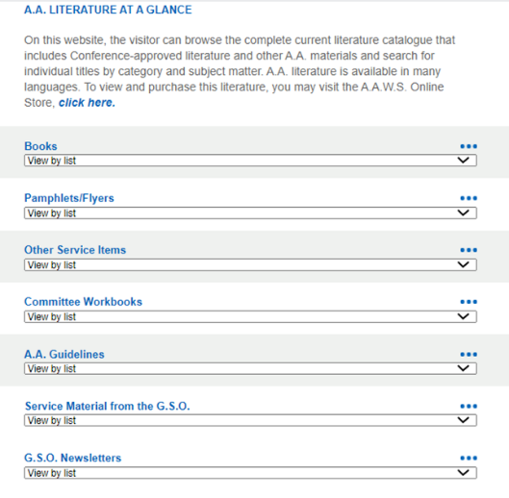
Resources Available To Support Your Service Positions
AA Approved Literature is listed at: https://www.aa.org/pages/en_US/aa-literature
This is the landing page
Use the dropdown menus to view the list of material available under each category.

Slide 16
Resources Available To Support Your Service Positions
The A.A. Service Manual Combined With Twelve Concept for World Services
Both in a single booklet and one of the most helpful manuals that will help you understand general service. It opens with a history of A.A. services; explains the Conference structure and its year-round importance; includes the Conference Charter and General Service Board Bylaws. The Concepts—principles of service that have emerged from A.A.’s service accomplishments and mistakes since its beginning— are set forth by Bill W.

Slide 17
Resources Available To Support Your Service Positions
Alcoholics Anonymous Comes of Age
A wonderful book that explains our A.A. history and where Bill W. tells the story of how the A.A. Fellowship grew, from its beginnings in New York and Akron to its spread across the country and overseas. Through the lens of the Three Legacies of Recovery, Unity and Service, Bill explains how the Twelve Steps, the Twelve Traditions and the Twelve Concepts for World Service evolved.

Slide 18
Resources Available To Support Your Service Positions
Our Great Responsibility
One of the newer publications from A.A. World Services is a selection of Bill W.’s General Service Conference talks from 1951 to 1970. Timeless and timely, these 16 talks give fresh perspectives on the A.A. Fellowship in our co-founder’s own words.

Slide 19
Resources Available To Support Your Service Positions
The A.A. Group
One of the most popular pamphlets that you will find very helpful is P-16 – The A.A. Group, an informal guide that tells how a group works most effectively; how a new group can be started, and how each group can be linked to A.A. as a whole.

Slide 20
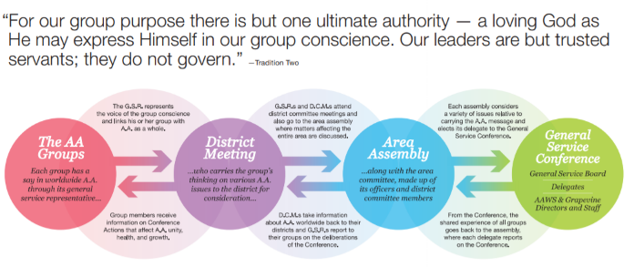
Resources Available To Support Your Service Positions
Circles of Love and Service
Circles of Love and Service. This leaflet outlines our service structure in full-color diagrams. (P-45)

Slide 21
Resources Available To Support Your Service Positions
A.A. Tradition – How it Developed
A tour of the historical events that lead to our unique Twelve Traditions. (P-17)

Slide 22
Resources Available To Support Your Service Positions
G.S.R. General Service Representative
Your group's link to A.A. as a whole. For a new general service representative, this leaflet outlines responsibilities and useful sources of information; for a group, what to keep in mind when electing a G.S.R. (P-19 GSR)

Slide 23
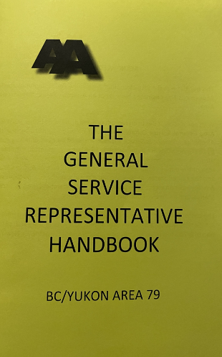
Resources Available To Support Your Service Positions
GSR [General Service Representatives] Handbook
This Area 79 publication was the idea of another Area in the Fellowship of Alcoholics Anonymous and originated because of an Assembly Action taken by that Area.
With permission, it has been reproduced and distributed by the BC/Yukon Area General Service Committee. It is in no way meant to replace the Alcoholics Anonymous Service Manual; it should be used only as a guide by the General Service Representative (GSR) or any interested member of Alcoholics Anonymous. It is hoped this booklet will give a more in-depth idea of the duties of the GSR and the Service Structure of A.A. in Canada and the United States.

Slide 24
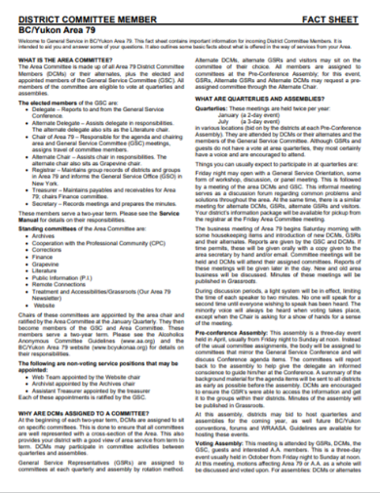
Resources Available To Support Your Service Positions
DCM [District Committee Members] Factsheet
This two-page fact sheet created by Area 79 contains important information for incoming District Committee Members.
It is intended to aid you and answer some of your questions. It also outlines some basic facts about what is offered in the way of services from your Area.

Slide 25
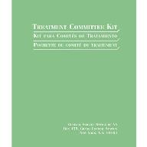
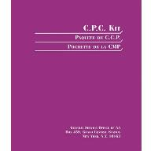
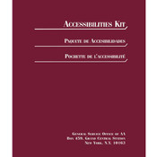
Resources Available To Support Your Service Positions
Committee Workbooks and Kits
These committee workbooks and kits offer a wealth of information to use in your specific committees.

Slide 26
Resources Available To Support Your Service Positions
https://www.aagrapevine.org/
The AA Grapevine Statement of Purpose
The AA Grapevine is the international journal of Alcoholics Anonymous. Written, edited, illustrated, and read by AA members and others interested in the AA program of recovery from alcoholism, the Grapevine is a lifeline linking one alcoholic to another.
Often referred to as our "meeting in print," the AA Grapevine communicates the experience, strength, and hope of its contributors and reflects a broad geographic spectrum of current AA experience with recovery, unity, and service. Founded in 1944, the Grapevine does not receive group contributions, but is supported entirely through magazine subscription sales and additional income derived from the sale of Grapevine items.

Slide 27
Resources Available To Support Your Service Positions
https://www.aagrapevine.org/
The Grapevine was created by six AA members in the New York area — four women and two men. With the blessings of AA's co-founder Bill W., they published the first issue in June 1944, just nine years after the founding of AA. ... Individual opinions expressed here are not, necessarily, those of AA as a whole.

Slide 28
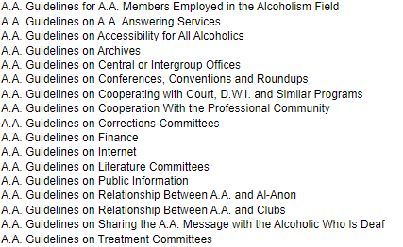
Resources Available To Support Your Service Positions
A.A. Guidelines
A.A. Guidelines are compiled from the shared experience of A.A. members in various service areas. They also reflect guidance given through the Twelve Traditions and the General Service Conference (U.S. and Canada). In keeping with our Tradition of autonomy, except in matters affecting other groups or A.A. as a whole; most decisions are made by the group conscience of the members involved. The purpose of these Guidelines is to assist in reaching an informed group conscience.

Slide 29
Resources Available To Support Your Service Positions
Past Trusted Servants
Area 79 has been blessed to have so many past delegates, trustees and GSC committee chairs continuing to guide our fellowship and attend assemblies and quarterlies to act as Elder Statesmen when called upon.
PAST DELEGATES, TRUSTEES, GSC COMMITTEE CHAIRS ETC.

Slide 30
Resources Available To Support Your Service Positions
GSC [General Service Committee]
ELECTED POSITONS
APPOINTED POSITONS
COMMITTEE POSITONS SERVED BY ALT DELEGATE AND ALT CHAIR
delegate@bcyukonaa.org
altdelegate@bcyukonaa.org
chair@bcyukonaa.org
altchair@bcyukonaa.org
treasurer@bcyukonaa.org
secretary@bcyukonaa.org
registrar@bcyukonaa.org
archives@bcyukonaa.org
corrections@bcyukonaa.org
cpc@bcyukonaa.org
publicinformation@bcyukonaa.org
remoteconnections@bcyukonaa.org
treatment@bcyukonaa.org
website@bcyukonaa.org
literature@bcyukonaa.org
grapevine@bcyukonaa.org
grassroots@bckyukonaa.org
(grassroots has been delegated to our Treatment and Accessibilities Chair)

Slide 31
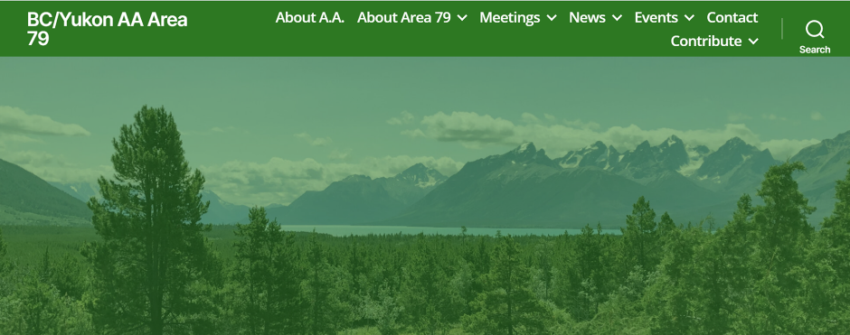
Resources Available To Support Your Service Positions
BC / Yukon Website: www.bcyukonaa.org
Here in Area 79 our website is made up of a public site and a “Trusted Servant” site (Working Site for GSRs, DCMs, and the GSC).
Contact your DCM or Website Chair/Team for login info.

Slide 32
GENERAL AA SERVICE CONFERENCE
3

Slide 33
General AA Service Conference
THE Conference Structure — An Overview
The U.S./Canada* Conference structure is the framework in which these “general services” are carried out. It is a method by which A.A.’s collective group conscience can speak forcefully and put its desires for Conference-wide services into effect. It is the structure that takes the place of government in A.A., ensuring that the full voice of A.A. will be heard and guaranteeing that the desired services will continue to function under all conditions.
Today, general services include all kinds of activities within the Conference structure, carried on by groups, districts, area committees, delegates, trustees, the General Service Office and the Grapevine. Usually, these services affect A.A. as a whole.
Source: The AA Service Manual, Chapter One, page S15

Slide 34
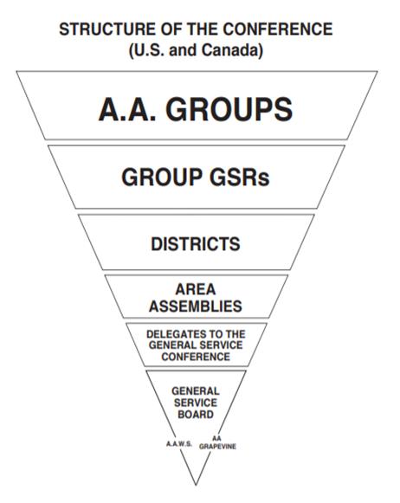
An Upside-Down Organization
Alcoholics Anonymous has been called an upside-down organization because, as the structure chart shows, the groups are on top and the trustees at the bottom. Bill W. wrote in Concept I: “The A.A. groups today hold ultimate responsibility and final authority for our world services.…” Then, in Concept II, Bill made it clear that the groups “delegated to the Conference complete authority for the active maintenance of our world services and thereby made the Conference… the actual voice and effective conscience for our whole Society.”

Slide 35
Flow Chart of a Conference Advisory Action
… which if approved after full floor discussion becomes a Conference Advisory Action that becomes binding when approved by the…
… and is first shared or discussed at the group, district and Area Assembly and sent to the…
An idea suggestion, question, concern or subject comes from…
… who then refers the matter to the…
CONFERENCE
COORDINATOR
GSO
TRUSTEES COMMITTEE
ON THE GENERAL
SERVICE CONFERENCE
APPROPRIATE CONFERENCE
COMMITTEE
GENERAL SERVICE
CONFERENCE
GENERAL SERVICE
BOARD
… A.A. members, GSRs, DCMs, Area Committee members, Delegates,
Trustees or GSO/GV Staff
The idea is discussed by the GSO Staff and sent to the…
… which meets during the General Service Conference Week and makes a recommendation that goes in the Committee Report to the…

Slide 36
AREA 79 APRIL 2021 PRE-CONFERENCE
4

Slide 37
Pre-Conference Instructions
PRE-CONFERENCE 2021
CONFERENCE AND POST-CONFERENCE 2021
Delegate/ General Service Committee & DCMs

GSR

Delegate



Feb 6th (or so) Delegate receives list of proposed agenda items from GSO
Jan 1st - April 1st GSR and Alt GSR , Alt DCM can email Alt Chair for committee pre assignment (see Pre-Conference Committee Assignment document in your agenda package)
April 18th -24th 2021 Delegate takes feedback from groups received at the Pre-Conference Assembly to the General Service Conference (virtual) in New York.
Assignment document in your agenda package


March 2nd (or so) GSR receive email from DCM ’s advising that agenda items and background material are posted on
Area 79 website

Feb 15th (or so) Delegate receives full background material and sorts into committees
First Delegate Report May 15th, 2021 Delegate brings information back to the districts from the General Service Conference via the Delegate Report.
They give feedback on decisions and considerations made. These decisions are based on the information sent from the groups at the Pre–Conference Assembly.


GSR download agenda items and background material pertaining to your committee and your DCM’s committee from Area 79 Website area79@bcyukonaa.org Delegates page
Feb 17th -21st (or so) General Service Committee work on synopsize background material into 4 pages per committee

Bring GSR and DCM agenda items with background material to your home group business meeting. Feedback should be collected from group members prior to the April Pre Conference Assembly held April 9th -11th

Feb 22-24 Delegate will gather all sheets create one document, review with all committee members then assist with uploading synopsis to Area 79 Website

Note: Some Groups hold a special meeting apart
from business meeting

March 2nd (or so) Delegate will send email to DCM advising that documents are on website. DCM contact GSR to advise same and support GSR through process

Bring feedback from your group to the April Pre Conference Assembly committee meeting for further discussion

Slide 38
WESTERN CANADA REGION ALCOHOLICS ANNOYMOUS SERVICE ASSEMBLY [WRAASA]
5

Slide 39
Save the Date for the Upcoming 2021 WRAASA
The purpose of WRAASA is to develop greater unity among the members, groups, and areas of Western Canada Region (WCR); to encourage the exchange of ideas and experiences; and to provide an opportunity for members to discuss pertinent aspects of A.A. The Assembly should always foster the RECOVERY, UNITY, and SERVICE legacies of A.A. The Areas of the Western Canada Region sponsor WRAASA. The Region boundaries are as designated in the A.A. Service Manual. WRAASA is held every two years in one of the western regions of Canada as per rotation.

Slide 40
Working with Others by Bill W.
We are going to end this in Bill’s own words as to the importance of working with others.

Slide 41
Closing Quote By Bill W., General Service Conference, 1964
We are propelled to this Society by the threat of death itself by alcoholism”, Bill suggested. “But when we have acquired a little grace and some of the mist has passed from our eyes, we find ourselves in a new world. We also find that we are faced with immense responsibilities; for our own growth and development, for the welfare of our Group, for the welfare of A.A. as a whole, for better homes, for better relations with the world around us.

Slide 42
Please submit any questions to our Area Secretary and they will be answered during our Ask It Basket sessions. They will also be included in our next Grassroots edition.

